Slide 1
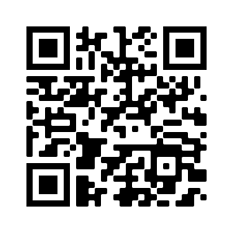
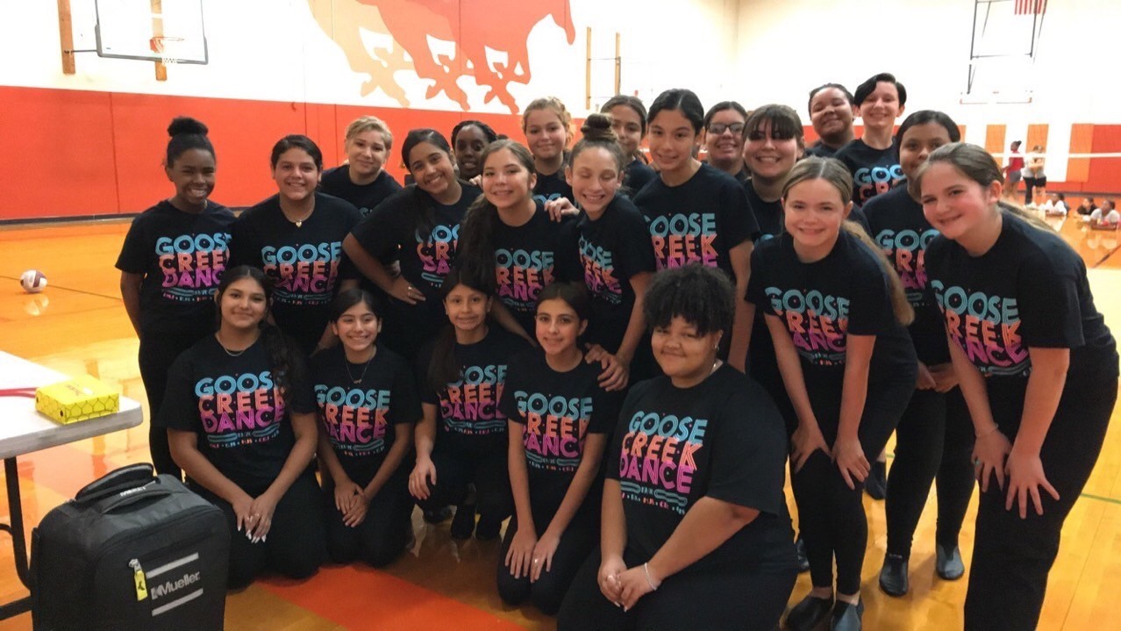
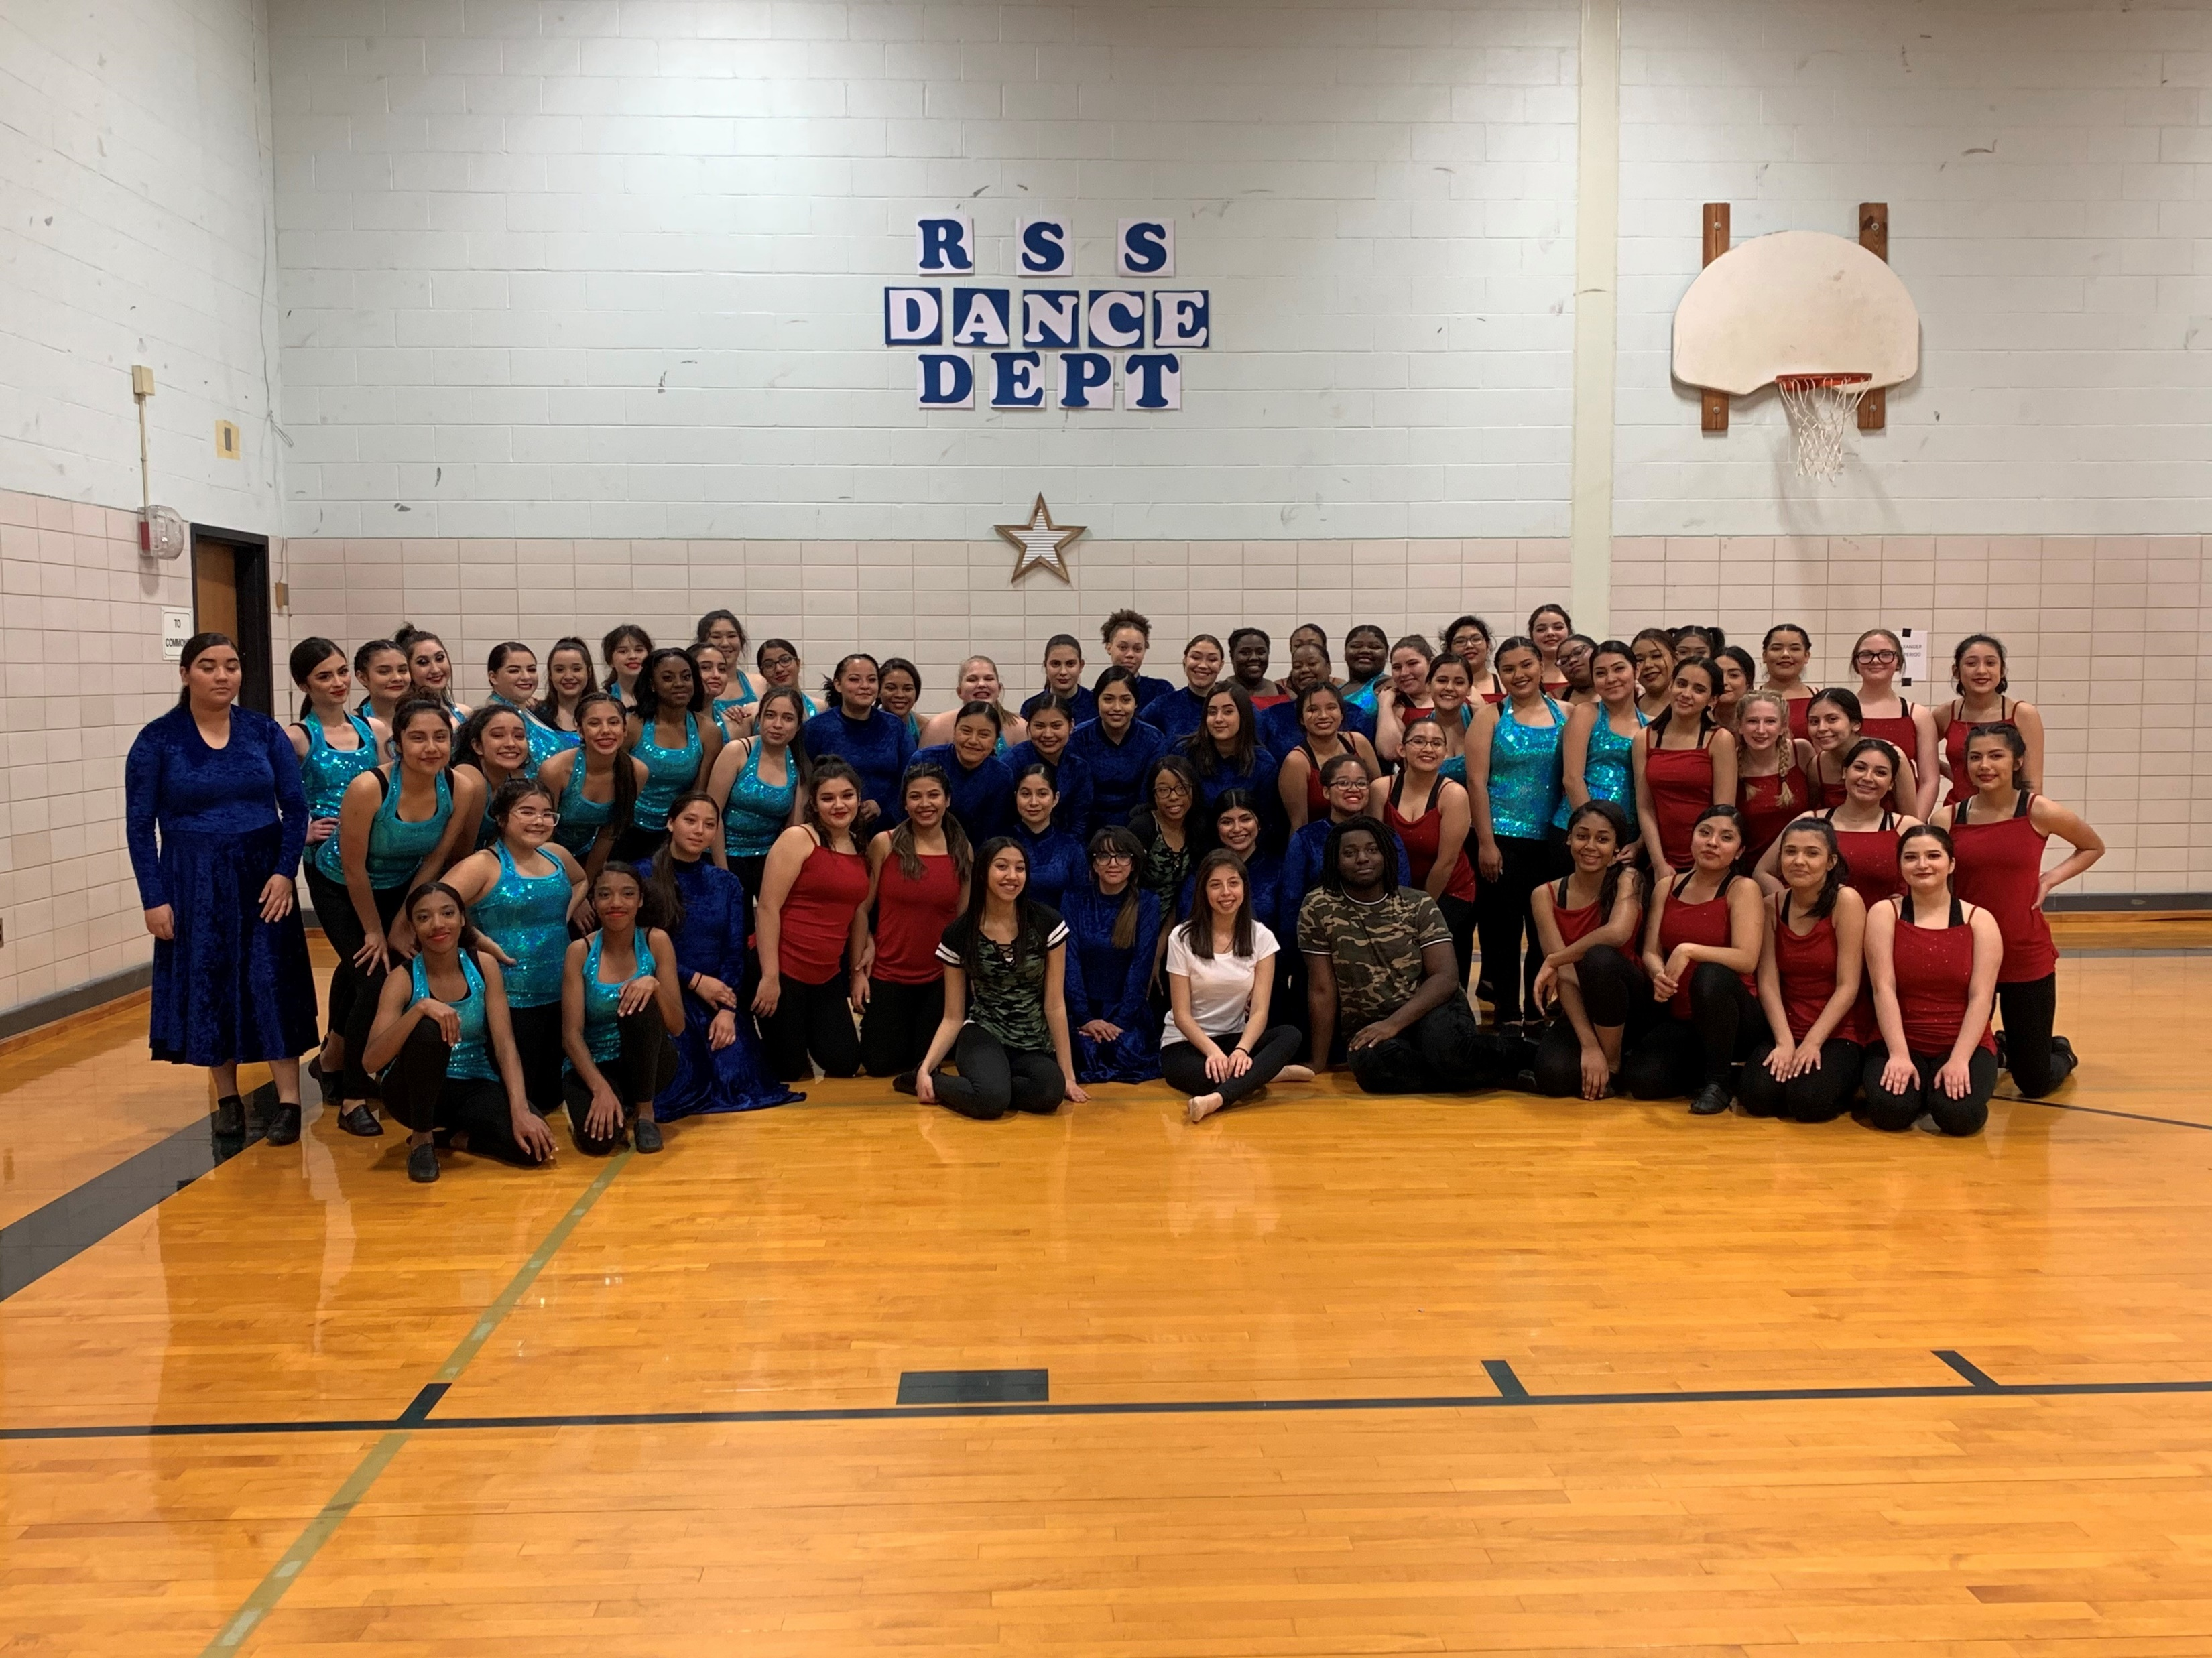
RSS Dance Dept
Do you like to dance?”
“Are you looking for that place to call your home away from home?”
“Do you want to earn credit for having fun with your friends and dancing during the school day?”
Then sign up for:
DANCE 1 – Fine Arts Credit
Dance Aerobics – PE Credit
You will learn lots of great skills, techniques and styles of dances including:
Ballet Jazz
Lyrical/Contemporary Hip Hop
Line Dances Social Dances
Turns, Leaps, and other technical skills
Drill Technique Splits
Strength & conditioning – lose weight and get those six pack abs you always wanted!
Learn what you need to know to be a Star or Sapphire one day!
Make new friends!!
You will have the opportunity to make up your own dances!
You get to perform in our annual district-wide Fall Premiere & RSS Spring Dance Showcase for your family and friends!
You can be in Dance 1/Dance Aerobics
even if you are in other sports,
cheerleading, band, choir, theater, etc!
This Photo by Unknown Author is licensed under CC BY-SA

